Slide 1
Elastic Sales Program Overview
July 13, 2022

Slide 2
Elastic Sales Program Overview
Sales Program Rules
Other Considerations
When is the sales program valid?
Who is eligible?
What must be purchased to qualify?
Groups & Tiers
Exclusivity
Order vs. Shipment Level
Sales Rep Review
Web Order Interface
Sales Program Awards
Discounts
Preferential Payment Terms
Free Freight
Price Group Override
Custom Override Request (Rep)
Sales Program Setup
Elastic Admin Site
Sales Program Spreadsheet

Slide 3
Sales Program Rules

Slide 4
Sales Program Catalog Rules
Catalog Is
Catalog that order is placed from is included in the rule
Example: Catalog is “F23 Prebook”
Catalog that order is placed from is not listed as excluded
Catalog Is Not
Example: Catalog is not “At Once”
Catalog Season Is
Season Code of the catalog is included in the rule
Example: Catalog Season is “FALL23”
Season Code of the catalog is not listed as excluded
Catalog Season
Is Not
Example: Catalog Season is not “FALL22”

Slide 5
Sales Program Date Rules
Effective From
Ship Date After
Order Submitted After
Effective date of the sales program (first date program available)
Requested Ship Date on order must be >=
this date
Date order submitted in Elastic must be >=
this date
Effective To
Ship Date Before
Order Submitted Before
Expiration date of the sales program (last date program available)
Requested Ship Date on order must be <=
this date
Date order submitted in Elastic must be <=
this date

Slide 6
Sales Program Customer & User Rules
Region Is
Region Is Not
User Type Is
User Type Is Not
Customer Sold To Account is associated with a region listed in the rule
Example: Region is“EMEA”
Customer Sold To Account is NOT listed as excluded from the sales program
Example: Region is not “EMEA”
User has a type (dealer or rep) that is listed as allowed for the sales program
Example: User Type is “Rep”
User has a type (dealer or rep) that is NOT listed as excluded from the sales program
Example: User Type is not “Dealer”

Slide 7
Sales Program Customer & User Rules
Account Group Is
Sold To has a customer tag (account group) that is listed as included in rule
Example: Tag “Customer Tier” is “Silver”
Account Group Is Not
Sold To does not have any customer tag (account group) that is listed as excluded
Example: Tag “Payment Terms” is not “Prepay”
Account Number Is
Sold To account number is listed as included in the sales program rule
Example: Account Number is “123456789”
Account Number Is Not
Sold To account number is not listed as excluded from the sales program
Example: Account Number is not “987654321”
Location Number Is
Ship To account number is listed as included in the sales program rule
Example: Location Number is “987654321”
Location Number Is Not
Ship To account number is not listed as excluded from the sales program
Example: Location Number is not “987654321”

Slide 8
Product Rules – Specific Product List
List of Style Numbers
Quantity
Specify eligible products at the style (model) level
Minimum quantity that must be ordered from the list to qualify
Eligible
Products
Qualifying Criteria
List of SKUs/EANs/UPCs
Amount
Specify eligible products down to the size level
Minimum value that must be ordered from the list to qualify
Examples: Order at least 500 units of products “ABC123”, “ABC234”, and/or “ABC345”
Order at least 10 units of SKUs “W91W221117WGNABM” and/or “W91W211105WBUFBM”
Order at least $200 worth of products “ABC123”, “ABC234”, or “ABC345”
Order at least €100 worth of EANs “5019973848002” and/or “5019973848003”

Slide 9
Product Rules – # of Matching Styles
Matching Styles is at Least
Minimum # of unique styles from the list that must be ordered to qualify
List of Style Numbers
Specify eligible products at the style (model) level
Eligible
Products
Qualifying Criteria
Matching Styles is at Most
Maximum # of unique styles from the list that can be ordered and still qualify
Examples: Order a minimum of 2 unique styles from “ABC123”, “ABC234”, “ABC345”, “ABC456”, “ABC567”
Order a maximum of 4 unique styles from “ABC123”, “ABC234”, “ABC345”, “ABC456”, “ABC567”

Slide 10
Product Rules – # of Product Groups
Matching Product Groups
is at Least
Minimum # of unique tag values from the list that must be ordered to qualify
List of Product Tag Values
Eligible
Products
Qualifying Criteria
Specify the product tag group and tag values to be matched against
Matching Product Groups
is at Most
Maximum # of unique tag values that can be ordered from the list and still qualify
Examples: Order products from at least 2 Categories within “Racquetball”, “Squash”, “Tennis”, “Pickleball”
Order products from at most 3 Categories within “Racquetball”, “Squash”, “Tennis”, “Pickleball”

Slide 11
Product Rules – Product Group Amt/Qty
Minimum Quantity
Minimum quantity of products having the specified tag values that must be ordered to qualify
List of Product Tag Values
Eligible
Products
Qualifying Criteria
Specify the product tag group and tag values to be matched against
Minimum Amount
Minimum value of products having the specified tag values that must be ordered to qualify
Examples: Order a minimum of 100 units having tag “Category” = “Racquetball”, “Squash”, or “Pickleball”
Order a minimum of $1,000 of products having product tag “Category” = “Tennis Balls”

Slide 12
Order Level Program Rules
Total Price at Least
Total Qty at Least
Order Type Is
Order Type Is Not
Minimum total order value to qualify for the sales program
Example: Total Price at least $5,000
Minimum total order quantity to qualify for the sales program
Example: Total Quantity at Least 200
Order Type assigned to the order is listed as included in the sales program
Example: Order Type is “Prebook”
Order Type assigned to the order is NOT listed as excluded from the sales program
Example: Order Type is not “Bulk”

Slide 13
Rules – Related Sales Program
Order meets criteria of sales program
Order meets criteria of sales program
=
By meeting the criteria of related sales programs 1 & 2, order also qualifies for sales program 3
Sales Program 1
Sales Program 2
Sales Program 3
Example: If order meets sales program 1 (order value > $1,500) and sales program 2 (order includes at least
50 units of products tagged as “New”), the order will qualify for an additional sales program that
awards free freight.

Slide 14
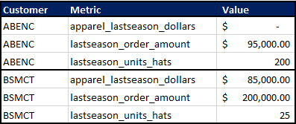
Sales Program Rules – Sales Metric
Published Metric
(Sold To Level)
Comparison Value
(Order or Product Group Level)
Increase to Qualify
(%/$/Units)
Order Total Amount Last Season
Total Amount of Current Order
+$500
vs
Qty of Hats Ordered Last Season
Order Qty for Category “Hats”
+100
vs
Order Total Amount Last Season - Apparel
Order Amount for Category “Apparel”
+20%
vs
Example Sales Metrics File:
(customer_amount_per_season.csv)

Slide 15
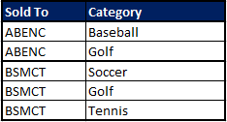
Rules – New Categories for Account
Compare product categories on the current order against the list of “new” categories for the customer as published in the metrics file
Soccer
New Groups is At Least
Minimum # of “new for account” categories to qualify for sales program
New Groups is At Most
Maximum # of “new for account” categories that will still qualify for sales program
Golf
Example New Category File:
(new_catagories_per_customers.csv)
Tennis
Baseball
Basketball

Slide 16
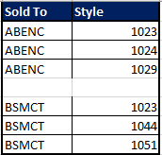
Rules – New Products for Account
Compare styles on the current order against the list of “new” styles for the Sold To customer as published in the metrics file
Style 1023
New Products is At Least
Minimum # of “new for account” products to qualify for sales program
New Products is At Most
Maximum # of “new for account” products that will still qualify for sales program
New Products with a Total Amount at Least
Minimum value of “new for account” products on the order to qualify for sales program
Style 1044
Style 1051
Example New Product File:
(new_products_per_customers.csv)
Style 1024
…
Style 1029

Slide 17
Sales Program Awards

Slide 18
Awards – Percent or Amount
Setup Parameters
Awards a percent or flat amount off of the order
Examples:
$20 off entire order (header level)
10% off entire order
$2 off each item on order
$5 off each item that matches the sales program eligibility rules
15% off each item that matches the sales program eligibility rules
Value
Type
Apply To
Value of the Discount
(e.g., 2 for $2.00
or 20 for 20%)
Percent Off
Amount Off Item
Amount Off Order
Entire Order
Only Items that Match Rules

Slide 19
Awards – Payment Terms
Setup Parameters
Applies a specific invoice payment term to the order
Examples:
10% 60 Net 61
Net 90
Terms
Terms Code
Apply To
Description of the awarded terms (as displayed to the user)
Terms Code to be passed to the ERP on the web order (e.g., N90 for Net 90)
Entire Order
Only Items that Match Rules

Slide 20
Awards – Ship Method (Free Freight)
Setup Parameters
Applies a specific ship method to the order (typically used for free freight)
Ship Method
Ship Method Code
Checkout Message
Apply To
Description of the awarded ship method (as displayed to the user)
Ship Via Code to be passed to the ERP on the web order
Custom text displayed on the checkout screen when this award is applied
Entire Order
Only Items that Match Rules
Notes: If the ship method applies to the entire shipment, the user will see the specifics ship method applied on the checkout page and will
not be able to change the ship method. If the ship method only applies to a portion of the order (items that match the eligibility
rules), the “checkout message” should direct the user to choose a ship method for items that do not qualify for the promotional ship
method.

Slide 21
Awards – % Off Specific Product Groups
Setup Parameters
Applies a percent off of items in specific product groups. Used when the items being discounted are different than the items used to determine eligibility.
Examples:
10% off category “Footwear” if purchasing > $500 of Apparel
20% off of items having Style Status value of “New Style”
Tag Group
Tag Values
% Off
The tag filter group identifying the products to discount (e.g., Category)
The tag values within the tag group identifying the products to discount
Numeric discount percentage to be applied to eligible items (e.g., 20)

Slide 22
Awards – % Off Specific Products
Setup Parameters
Applies a percent off specific products. The list of products to discount can be published at a style level or by specific SKUs/EANs/UPCs.
Examples:
10% off styles A, B and C
20% off of SKU W91W221117WGNABM
Level
Values
% Off
The level of the items in the value list:
Style
SKU/EAN/UPC
Comma separated list of style numbers or SKUs/EANs/UPCs
Numeric discount percentage to be applied to these products (e.g., 20)
Note: The only way to offer a “free with purchase” product in Elastic today is to set up a sales program for which the free item has a 100% discount if the sales program criteria to achieve the free product is met. However, there is currently not a way to limit the 100% discount to only a limited quantity – if the user gets 1 item free but orders 5 units of that item, all 5 get the 100% discount. Depending on the needs, we might be able to get around this with a “matching styles is at most” rule on the free product. Need detail on the programs that offer free product.

Slide 23
Awards – Price Group Upgrade
Setup Parameters
Overrides the price group applied to the order to a different price group
Example:
Upgrade the order from standard wholesale price group to a price group that has a 10% discount built in.
Price Group
Apply To
Price Group code to be applied if sales program criteria is met
Entire Order
Only Items that Match Rules
Note: The price group code specified in the “Price Group Upgrade” setting must be preceded with a “w” for wholesale (e.g., w10PCTOFF).

Slide 24
Awards – Custom Discount / Terms Request
Setup Parameters
This award allows a sales rep to request a specific discount and/or payment terms for the order.
Custom programs can be set up to require an approval workflow.
The type of discount the rep is allowed
to request (percent off or amount)
Custom Discount Type
The maximum percent or amount
value that the rep can request
Max % or Amount
Email address to which workflow
approval emails should be sent
Approver Email
The minimum percent/amount requiring approval (if request is below this value, no approval is needed)
Min for Approval
A list of valid payment term names/
codes that the rep can select from
Terms Codes
Checkbox indicating whether the rep can request
a specific payment due date (e.g., due 06/30/2023)
Custom Terms Date Allowed

Slide 25
Sales Programs – Other Considerations

Slide 26
Groups, Tiers and Exclusivity
Sales Program Groups
“Groups” group together a set of sales programs from which the user may only select one program. For example, there may be 2 sales programs offered for an order of a certain size with the user able to choose between free freight or longer payment terms
Tiers
Tiers allow a sales program to have separate awards based on different levels of achievement. For example, a discount of 5% for orders of $500-$999, 7% for orders of $1000-1499, and 10% for orders over $1500.
Sales Program Exclusivity
This option is used if Elastic should prevent the same item from having multiple discounts applied
If multiple sales programs could discount the same product, exclusivity priority tells Elastic to only apply the discount of the sales program whose group has the lowest exclusivity priority

Slide 27
Order vs. Shipment Level Application
Elastic Web Order – Total $23,000 / 400 Units
Elastic can evaluate sales program eligibility & apply sales programs at either an order level or a shipment level
NOTE: The decision of whether to use order or shipment level programs is a site wide election that applies to all sales programs on the website.
Shipment
Shipment
Shipment
Shipment
RSD 01/01/2023
RSD 02/01/2023
RSD 02/01/2023
RSD 03/01/2023
Ship To: Store A
Ship To: Store A
Ship To: Store B
Ship To: Store A
$5000 / 100 Units
$8000 / 125 Units
$8000 / 125 Units
$2000 / 50 Units
01
02
03
04
Example: If a sales program requires purchasing $7,500 of product, the entire order would be eligible if sales
programs are evaluated & applied at the order level, but only shipments 02 & 03 would be eligible if
evaluating at the shipment level.

Slide 28
Sales Program Setup – Other Items
Sales Rep Review
State
Show When Not in Cart
Sales programs only appear on the site when the state is “published” (not “draft”)
Requires rep review of dealer submitted orders having specific sales programs
Option determines whether program shows in “unachieved” list if required products not ordered
Sort
Description
Surcharges
Allows sorting sales programs in a specific order on the UI
Elastic sales programs can have a negative discount to apply a surcharge
Detailed program description for review to the Elastic user

Slide 29
Sales Programs – Web Order Interface
How sales programs and related discounts/terms are sent to the ERP is determined as part of the discovery re: web order formats.
In some cases, limitations in the ERP or middleware will restrict which sales program options can be offered on the Elastic website. Examples:
If the ERP cannot support passing in a shipment method override, that would prevent the use of sales programs having ship method awards.
If the ERP only supports 1 sales program per order, that would prevent Elastic from being set up in a manner that applies multiple sales programs to the same order.

Slide 30
Sales Program Setup

Slide 31
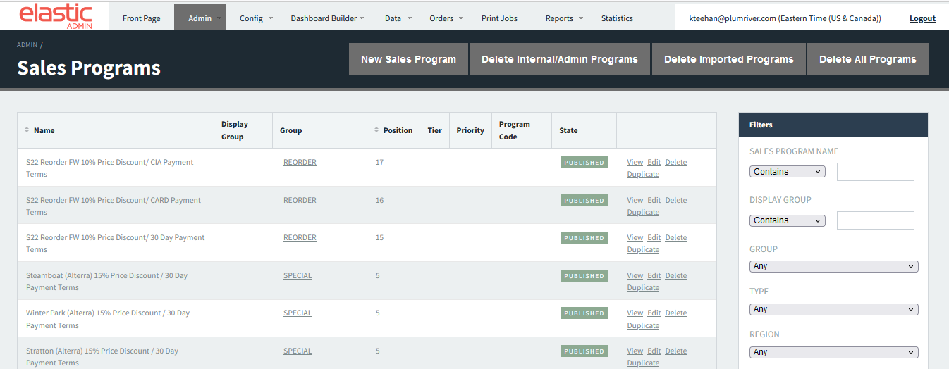
Admin Site - Manual Sales Program Entry
The Elastic admin site has basic functionality for maintaining sales programs manually.
Some types of programs – e.g., custom discount/terms requests – are not supported in the spreadsheet and must be set up in the CSP.
The admin screens can be cumbersome to work with and there is not a way to export sales programs to review the setup in bulk, so the sales program spreadsheet is recommended if a site has many (or complex) sales programs.

Slide 32
Sales Program Spreadsheet Upload
The sales program spreadsheet upload uses a pre-formatted Elastic template to allow for setting up sales program rules, awards and other details.
A sales program import process runs on a scheduled basis (typically nightly, but can be more frequent) to pull in new/updated sales programs.
Spreadsheet setup is recommended for sites that have many sales programs to maintain and/or have complex sales programs.

Slide 33
Questions

